Slide 1
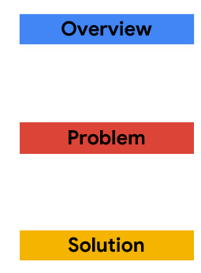

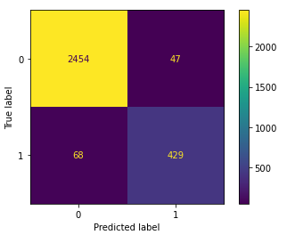
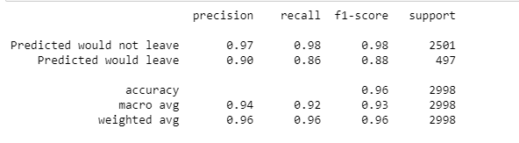
Salifort Motors – Predicting Employee Churn
Build a machine learning model to predict employees leaving the company and make recommendations on how to improve retention
Salifort Motors want to reduce employee churn. They have collated data from an employee survey to help determine the reasons for staff leaving. They want a machine learning model built that can predict if employees are likely to churn and want recommendations on how they can improve staff retention.
When staff leave Salifort Motors this represents a financial loss as they spend a lot of money on hiring and training staff. They don’t currently know the reasons for staff leaving, so they don’t know how to improve staff retention.
A logistic regression model was built as well as a random forest model. The random forest model performed best. It identified 86% of actual leavers as leavers. By surveying staff regularly (for example on a quarterly basis), the company can run the model to predict which staff are likely to churn. In addition by understanding the predictors of churn used in the model, management can then implement the correct intervention strategies to reduce employees leaving the company.
The random forest model results are as follows:
Recall (best metric) of predicting leavers out of all actual leavers out of all identified leavers was 86%
False Positives were 10% (leavers identified as non-leavers).
False Negatives were 2% (leavers predicted as not leaving)
F1 score which is a balance of recall and precision was 96%
To improve employee retention, the company needs to look at factors such as the number of projects, tenure, and hours which
Are all associated with higher leave rates. Overworked employees seem to be associated with higher leave rates and lower
satisfaction scores.

Slide 2
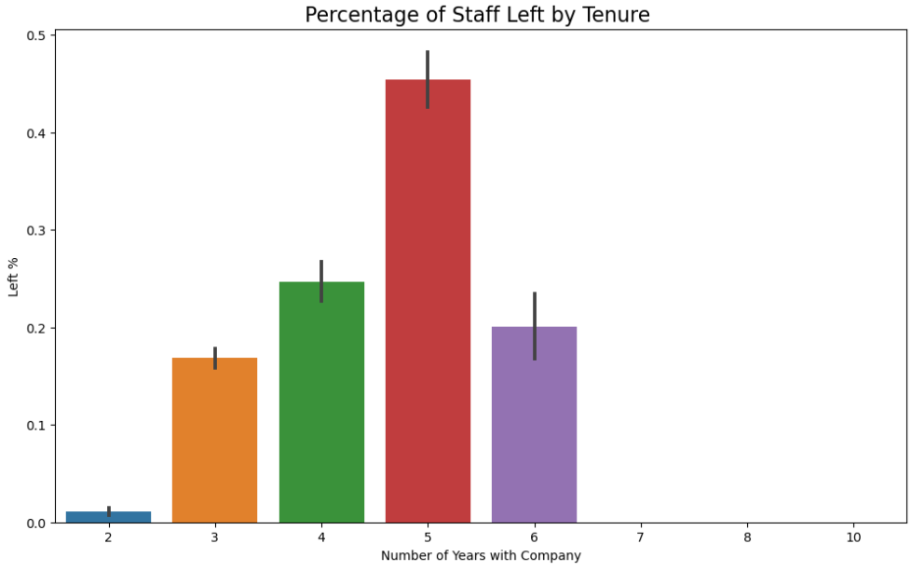
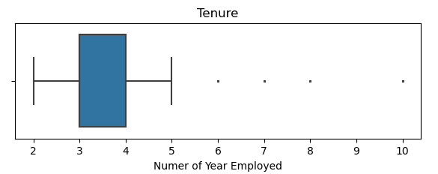
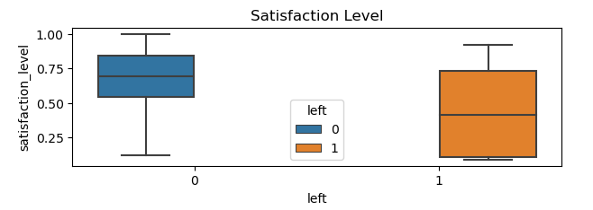
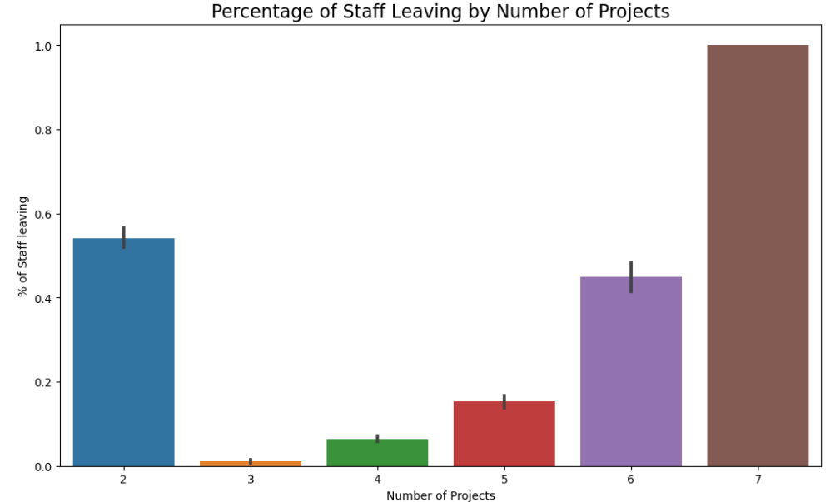
Feature Analysis
Tenure (how long staff have worked for the company) was found to have a number of outliers that were removed from the model
Tenure appears to be a good predictor of employee churn, with 5 years having the maximum churn rate.
Lower satisfaction scores were associated with higher leaving employee
As the number of projects increases, so does the likelihood of employee churn.
Note: 2 projects is associated with newer employee tenure.
Image Alt-Text Here

Slide 3
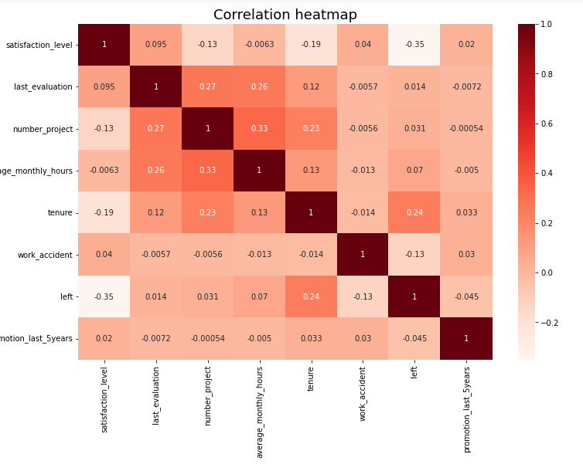
Correlation
Satisfaction has the highest correlation (negative) with leavers at -0.35
Tenure (years of work), was the next strongest at 0.24
There is a covariance between the number of projects and average monthly hours of 0.33. So, we may want to remove one of these features from the model.

